Slide 1
How to add your slide
Please leave this slide for other people to see
Only one slide is allowed
No animations please
You can cut and paste an image if you have the slide in some other format
Make sure that there is your student number on your slide
Insert your slide in student number order AFTER this slide

Slide 2
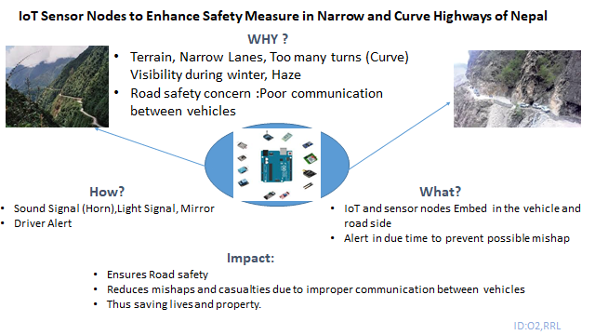

Slide 3

NO 3: Cloud Assisted ML Engine Feasible in South Asia?

Slide 4

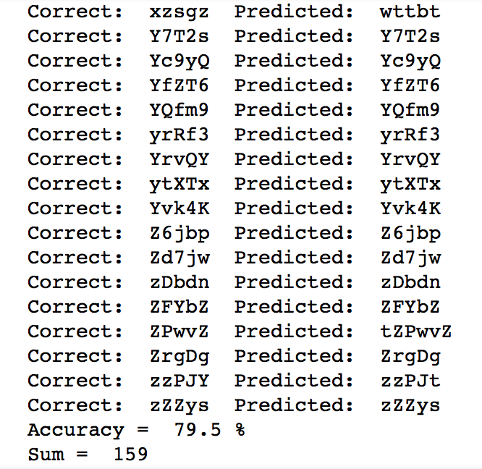

Breaking Text Based Captcha 4
https://tinyurl.com/captchaIOT

Slide 5
Implementation of Semantic Data Model In Nepal
Abstract:
Introduction : It is the data model for defining the conce

Slide 6
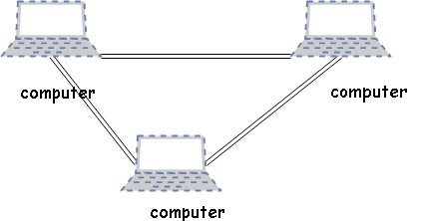
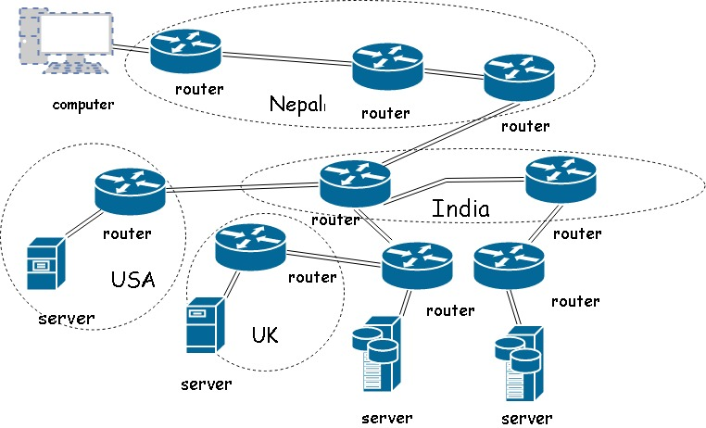

Networking in Nepal
Fig:interconnected computers
Fig: switch
Fig: bigger network
PRESENTER:Bikram Napit (6)

Slide 7
ROLLNO : 8

Slide 8
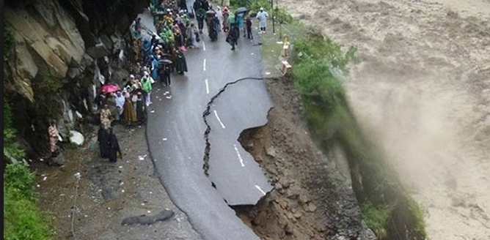
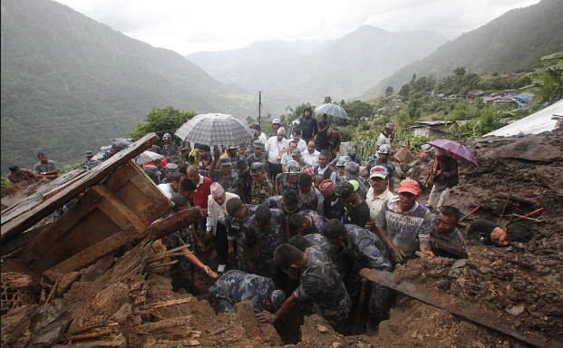
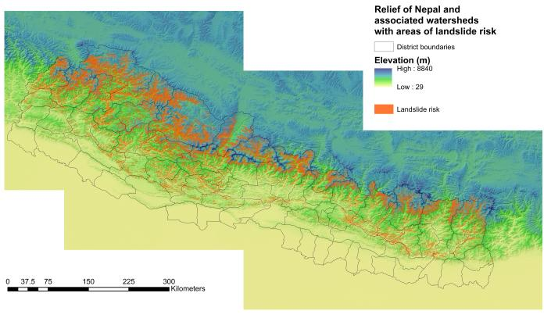
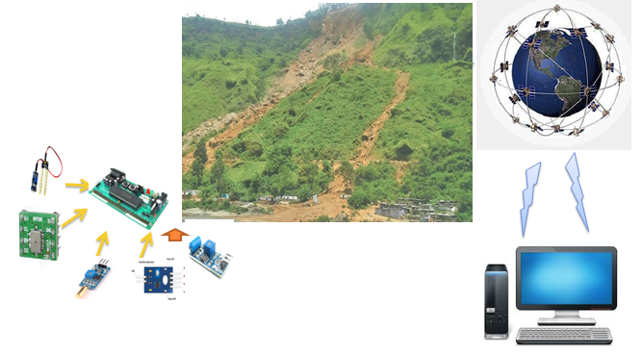

9.Detection and Prediction of Landslide in Nepal Using sensors and iot
Landslide scenario in Nepal
Proposed Method

Slide 9
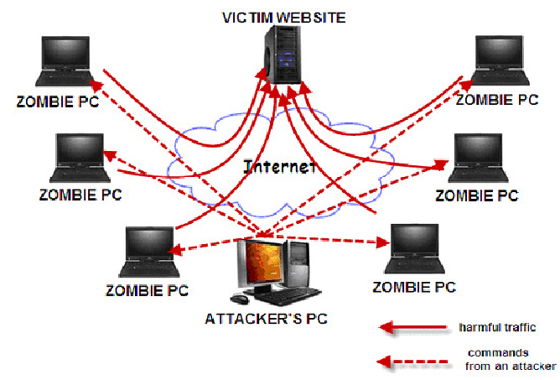
Mitigation of DDoS Attack
Hello ------ Hi---- Let’s Communicate
Then, Resources Allocated
Hello Vs Let’s Communicate & Randomness of Clients
Roll No. 10

Slide 10
Topic: Communication; the Challenges in Multicultural Team
To achieve a relevant information regarding the topic, I prepared the follows research question and objective:
RQ: How does a multicultural team communicate to its stakeholder?
Objective: to establish an effective and unique mode of communication
Why:
to maintain a smooth communication between team members & the stakeholders
to examine a relationship between the modes of communication: compatibility
to identify the barriers of smooth communication: Macro vs. micro barriers
How:
should focus on two major aspects of team communication i.e. formal vs. informal modes
Macro barriers: information overloading & misinterpretation, cultural diversity etc.
Micro barriers: lack of honesty & trust, customs, cast and religion problems etc.
to reduce the communication ambiguity
What:
For a smooth communication: design, develop and implement the different tools, templates, forms, formats used to solve the problems of information mis-interpretation, delayed in processing, communication channels problem, information ambiguities etc.
For communication barriers: team lead should use an effective formal communication mode.
Higher bandwidth
Roll no: 17
Notes:
DB Devkota, Roll No: 17

Slide 11
Notes:
Roll No:29

Slide 12
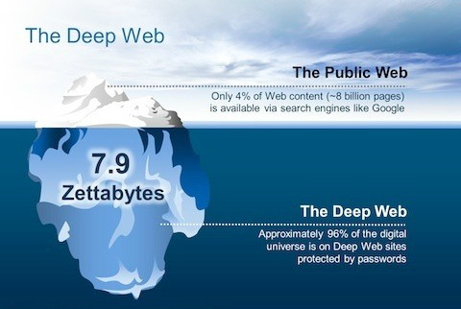
Web

Slide 13

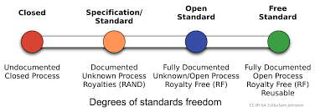

11
Standards
Interoperability

Slide 14
12_TDD vs TLD
Testing is important activity in any software development, and can have significant impact on developer productivity if we could pick suitable approach.
Two ways of testing : TDD and TLD, but lacks general consensus among developers
Same set of requirements are distributed to 10 teams (2 persons/team) of comparable skill set and experience. 5 teams did TDD, and rest did TLD
Teams using TDD produced code with 90% code coverage and more testable code, whereas team TLD produced 60 % code coverage and less testable code.
There was no significant difference in developer productivity in short term but can be beneficial over longer term.

Slide 15
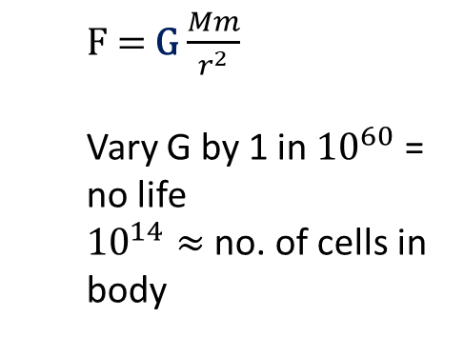
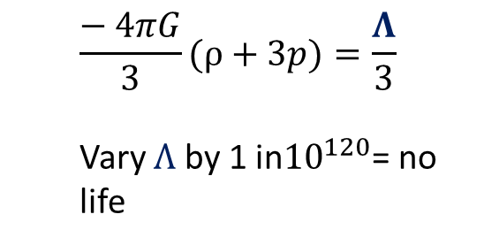
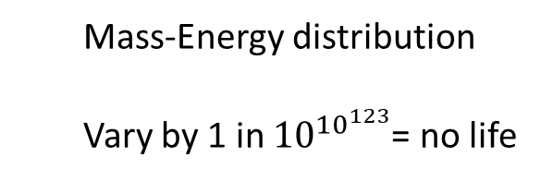
#15 Fine-Tuning of the Universe: The evidence for Design
Extremely narrow life permitting range.
Examples:
Explanations:
Necessity laws of nature are necessarily so
Chance Absurd improbability
Design The best candidate – super mind / God
References Burgess, C. and Moore, G. (2007). The standard model. Cambridge: Cambridge University Press. Barrow, J., Tipler, F. and Wheeler, J. (1996). The Anthropic Cosmological Principle. Oxford, New York: Oxford University Press.

Slide 16


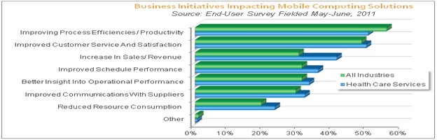
Green Computing
Green computing is use of the computer in environmentally friendly way and their resources.
To promote green computing concepts at all possible levels, the following four approaches are employed:
· Green use
· Green disposal
· Green design
· Green manufacturing
Name:Shweta Shrestha
Number :37

Slide 17


Approaches to avoid breaches on Networks
14

Slide 20
Notes:
Roll No: 31

Slide 22
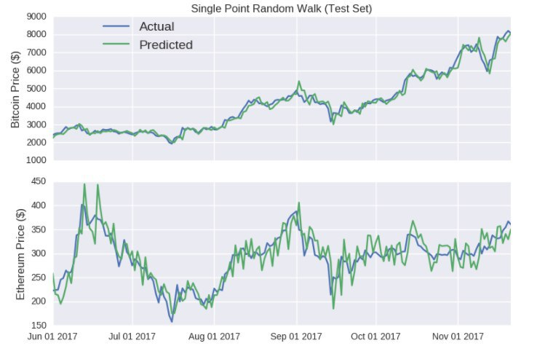
Cryptocurrency price prediction
21
Mangesh Dutta

Slide 26
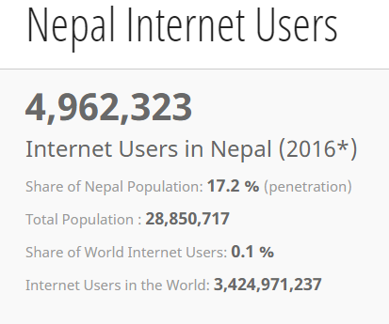
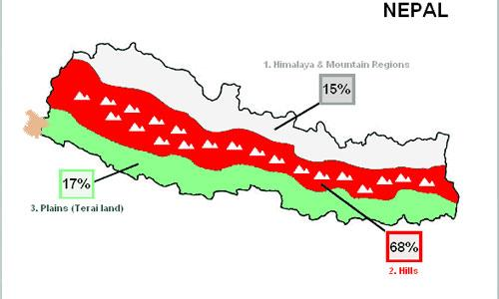
26
Less than 1% internet users in mountain areas
Notes:
26

Slide 30
How to do a Presentation 27
what to DO: -prepare in advance
-Think about audience
-Mesmerize your audience(Challenging statement, questions, quotations, pictures)
-Confident Intro
-Clarify the agenda
-Draft the body(do not cluster and confuse-- a sentence or paragraph)
-Conclusions(summarizations)
-Body language
what to Think while you do it:

Slide 31
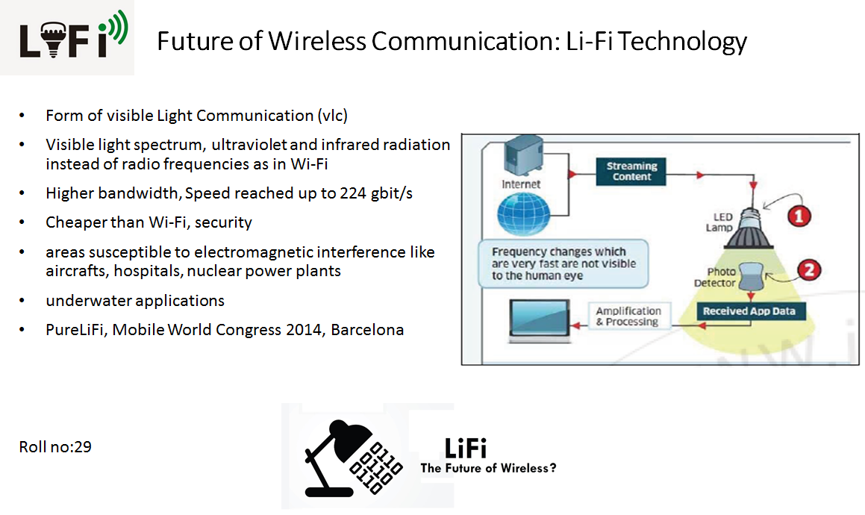
Notes:
Roll No: 29

Slide 32
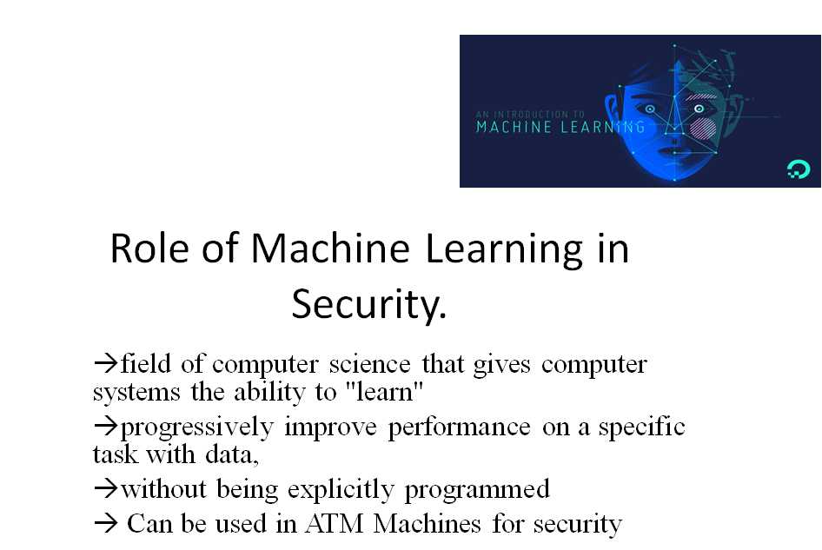
Notes:
Roll no. 30

Slide 33
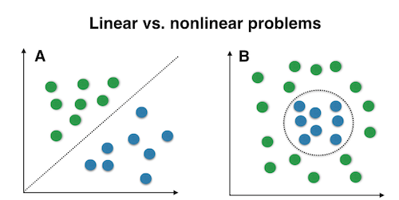
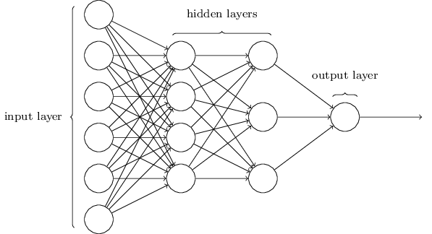
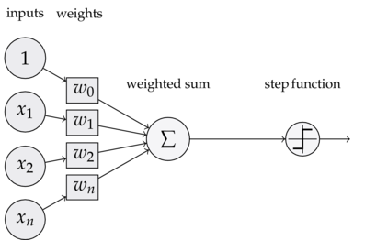
Role of activation function in neural network (No. 31)
Neural Network
Perceptron
Binary Classification Problem
Perceptron with activation function
Notes:
Roll No: 31

Slide 34



# 34:
Emulating Internet with
Pervasive Computing
83.3%!

Slide 35
No: 35

Slide 36
Evolution of Data & its usage
participant no.: 36
What is data
Reference about external world expressed in characters, texts, numbers
Early forms of storage was punch cards.
Today we have RDBMS, noSQL
Its importance
Electronic data processing added business value
This gave rise to IT
Development of data mining and uses
IBM uses heart monitoring data to predict disease.

